Slide 1
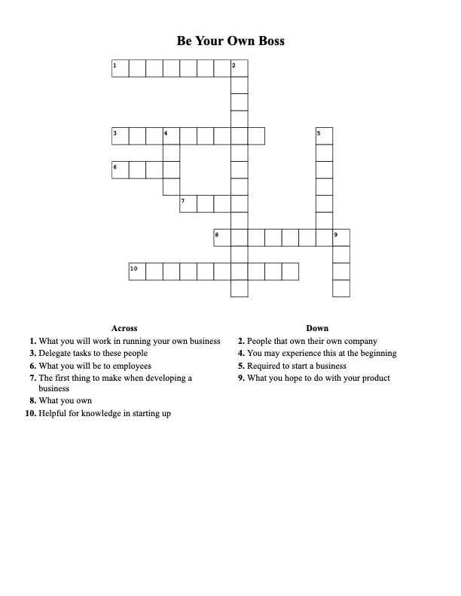
Sign in and save results:
BE YOUR OWN BOSS

