Slide 1
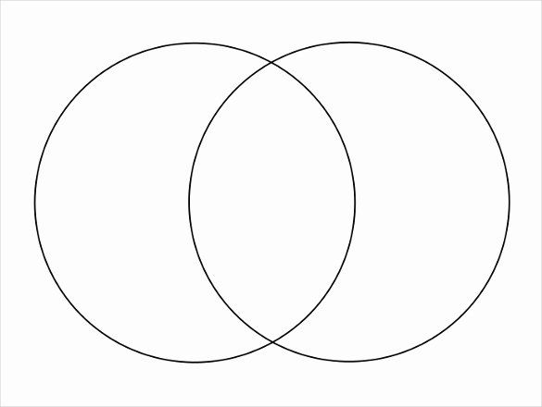
Sign in and save results:
REALITY CHECK
Venn Diagram of Wants vs. Needs
Place the items in either wants or needs. If it considered both, place in the middle.
Wants Needs
Insurance
Vitamins
Laptop
Groceries
Cable/TV
Cell Phone
Wi-Fi
Credit Card
Take Out From Restaurant
House
Movies
Car
Coffee

